Slide 1
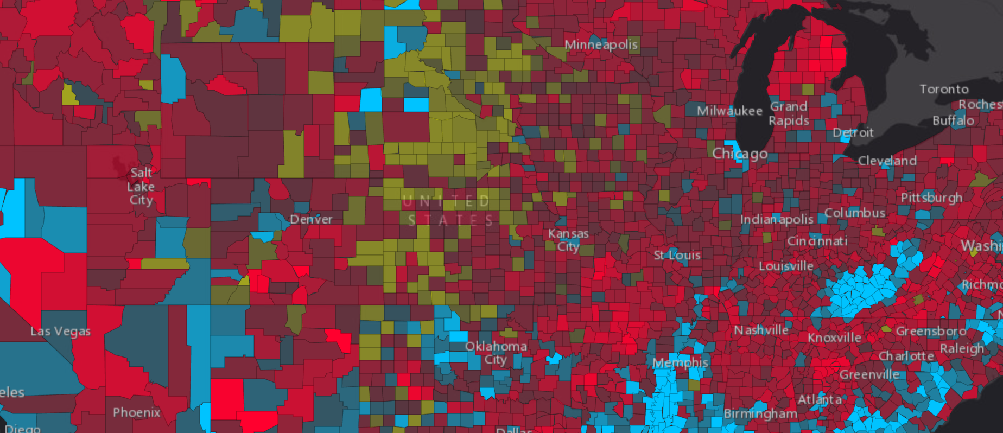
2D Visualization with the ArcGIS API for JavaScript
Thursday, March 09
1:00pm – 2:00pm (Primrose C-D)

Slide 2
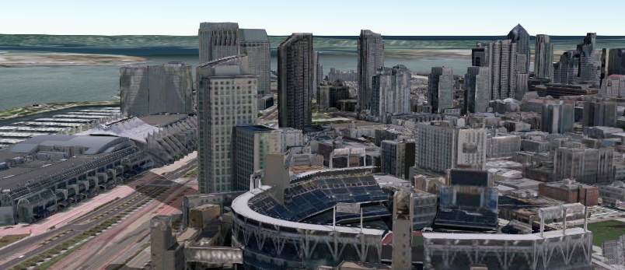
Practical Guide to Building 3D Web Apps
Thursday, March 09
9:00am – 10:00am (Primrose A)

Slide 3
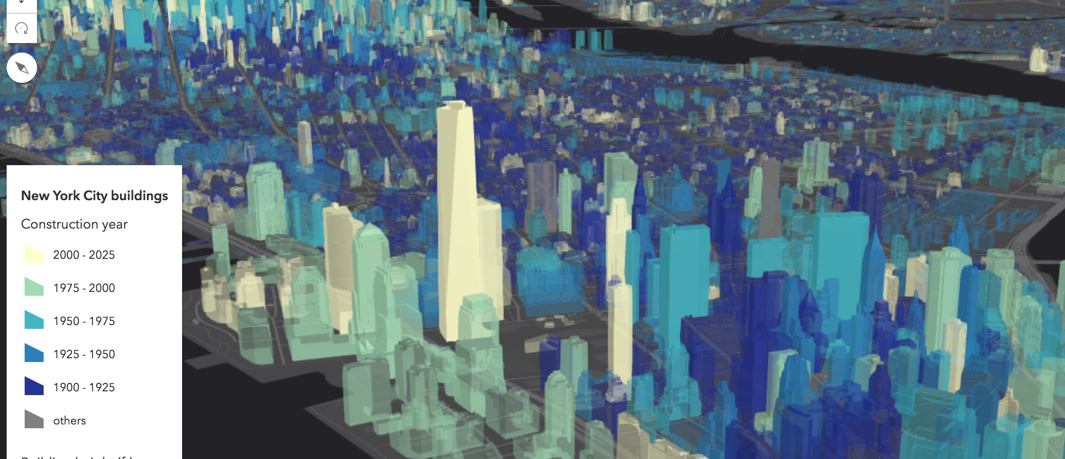
Bringing Your Data to Life in the ArcGIS API for JavaScript: 3D Objects
Tuesday, March 07
5:30pm – 6:00pm (Demo Theater 1)

Slide 4
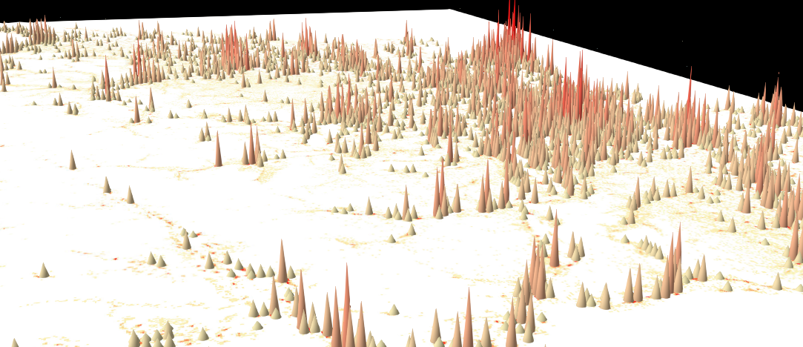
3D Visualization with the ArcGIS API for JavaScript
Wednesday, March 08
1:00pm – 2:00pm
(Pasadena-Sierra-Ventura)

Slide 5
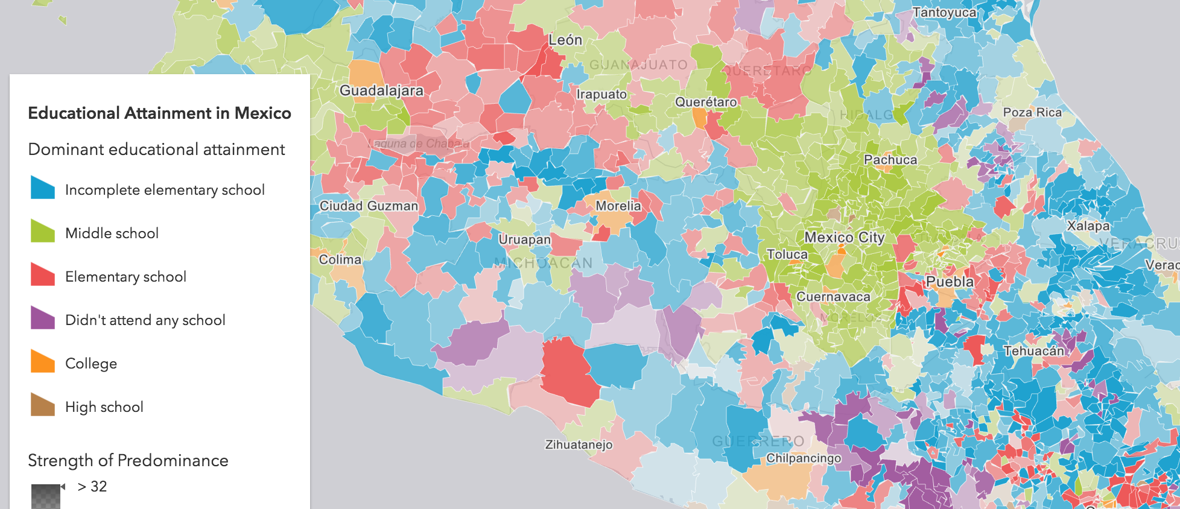
ArcGIS API for JavaScript: Using Arcade with your Apps
Thursday, March 09
5:30pm - 6:30pm (Primrose A)

Slide 6
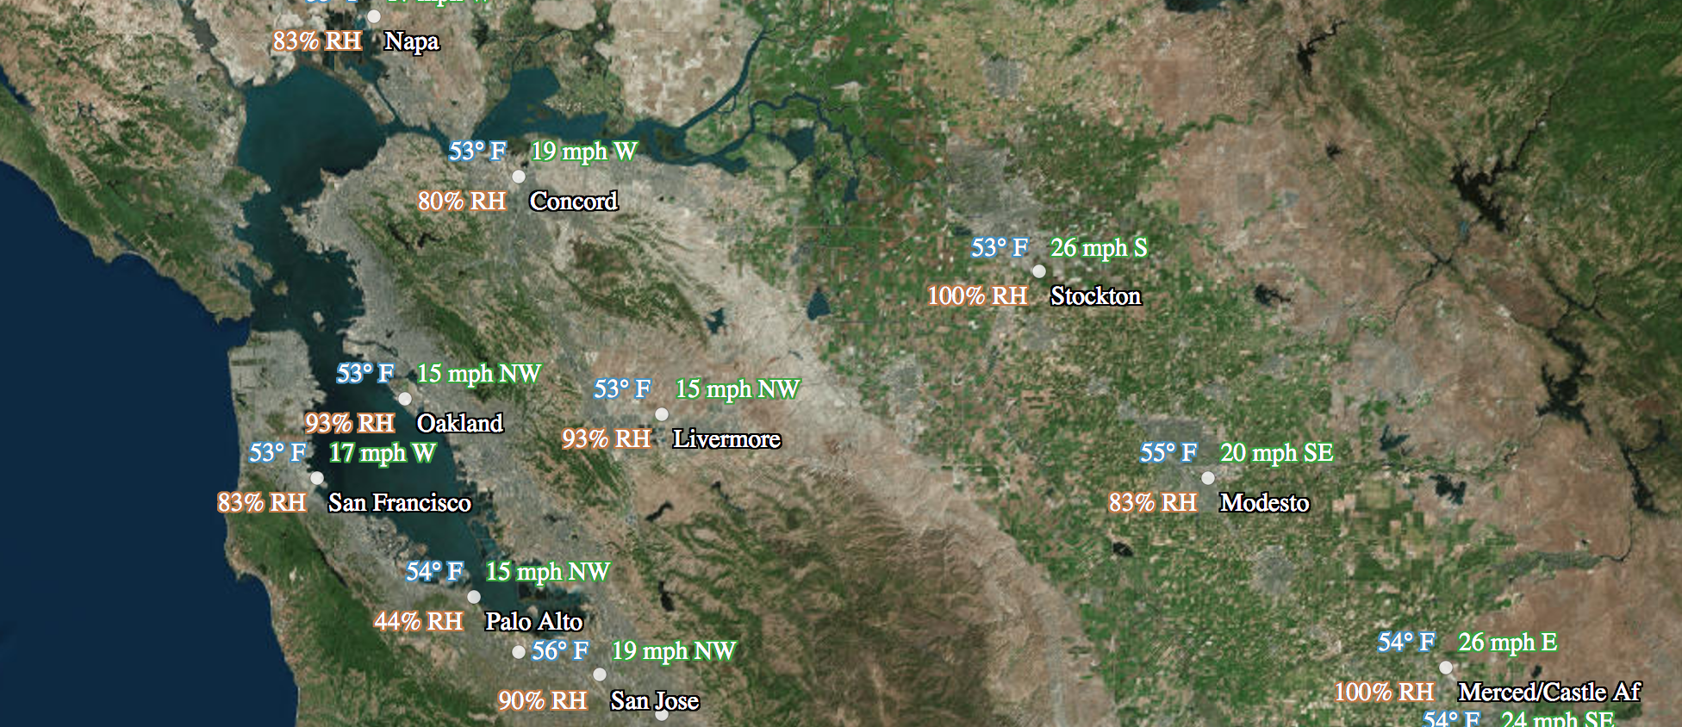
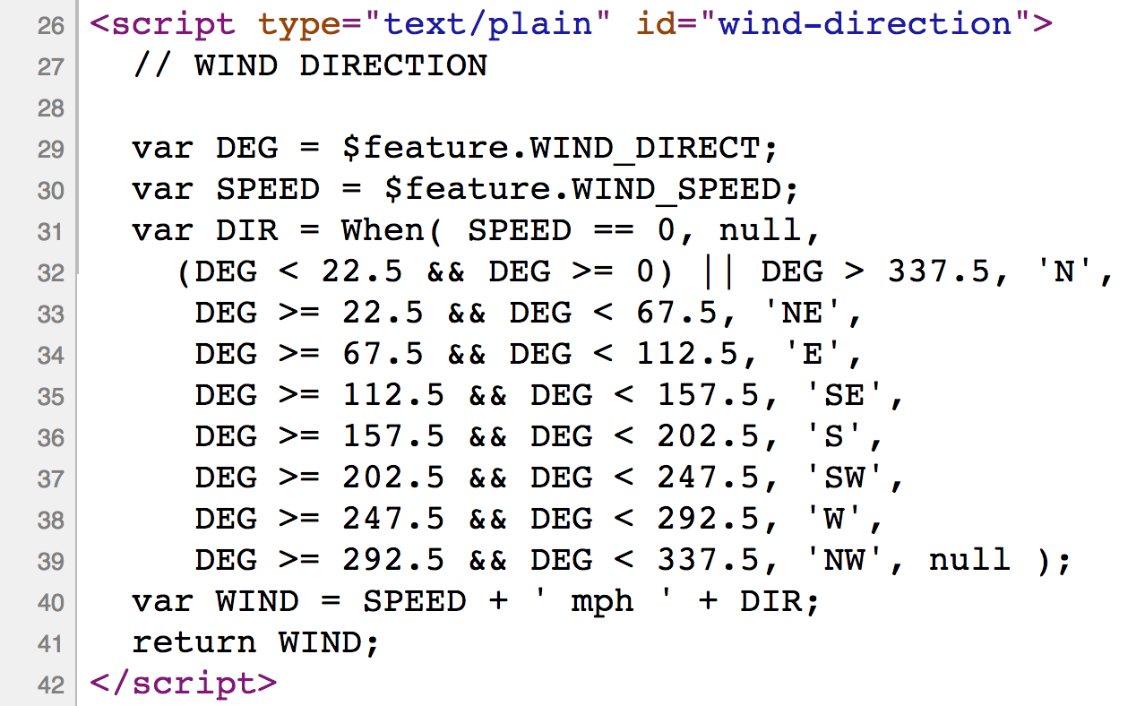
Using Arcade in your ArcGIS API for JavaScript Apps
Wednesday, March 08
2:30pm – 3:00pm (Demo Theater 1)

Slide 7
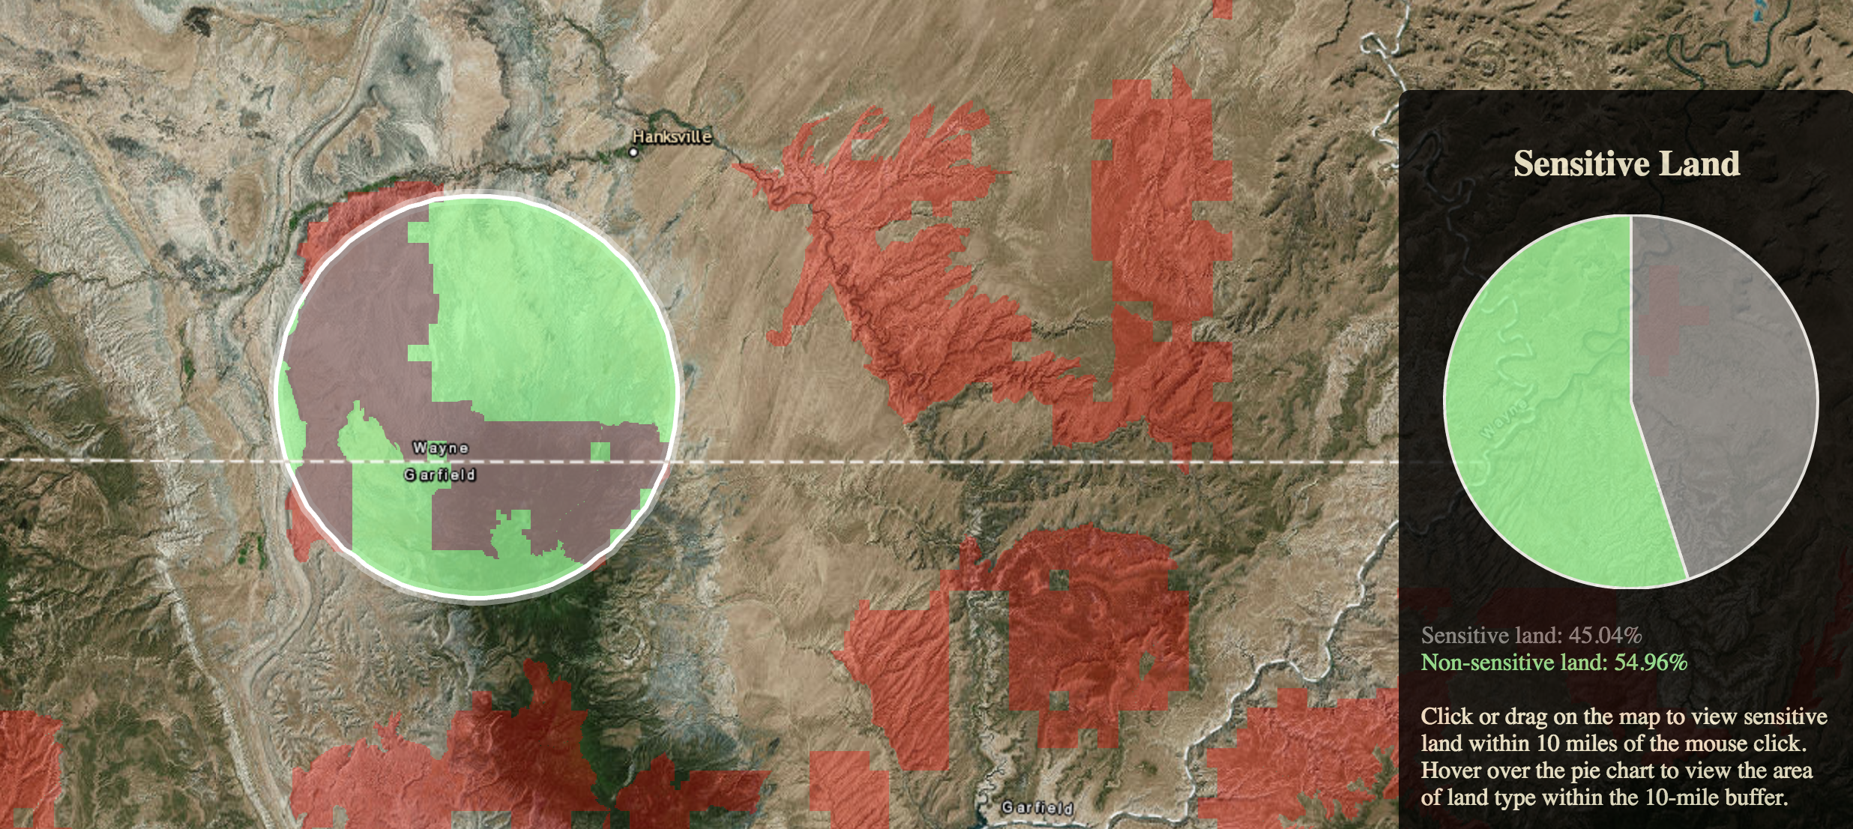
Building Interactive Web Apps Using the JavaScript API's Geometry Engine
Thursday, March 09
10:30am - 11:30am (Primrose C-D)

Slide 8
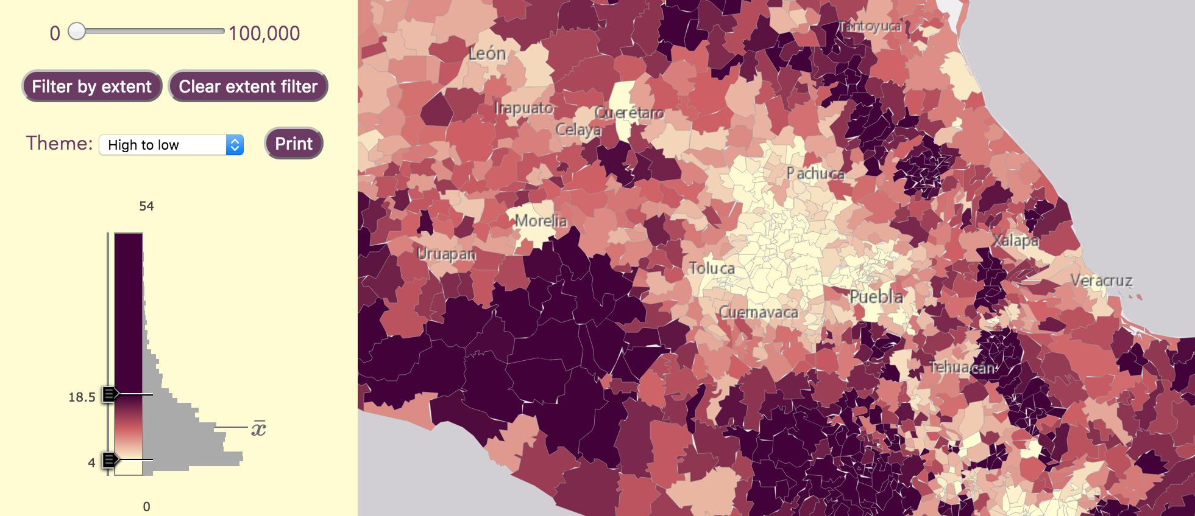
Building a Web App for Data Exploration with Smart Mapping
Thursday, March 09
2:30pm – 3:00pm (Demo Theater 1)

